Slide 1

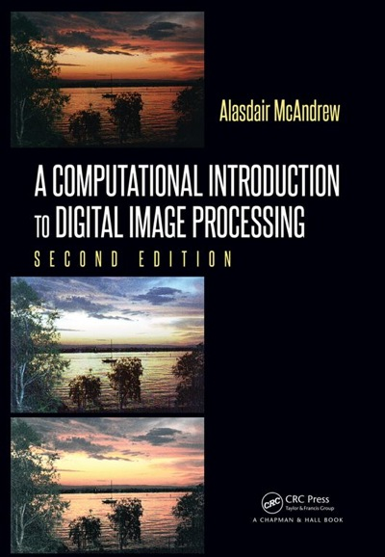
Chapter 8
Image Restoration

Slide 2

Contents
Introduction
Noise
Cleaning Salt and Pepper Noise
Cleaning Gaussian Noise
Removal of Periodic Noise
Inverse
Weiner Filtering

Slide 3
Introduction
Concerns removal or reduction of degradations that occurred during image acquisition
Noise: errors in pixel values
Optical effects: out of focus blurring
Blurring due to camera motion
Image restoration is one of the most important areas of image processing
Focus: techniques for dealing with restoration

Slide 4
Noise
Definition: any degradation in the image signal, caused by external disturbance
Cleaning an image corrupted by noise is an important area of image restoration
Look at 4 different noise types:
Salt and Pepper Noise
Gaussian Noise
Speckle Noise
Periodic Noise
Clean using spatial filtering techniques, local degradations
Clean using frequency domain filtering, global effect

Slide 5
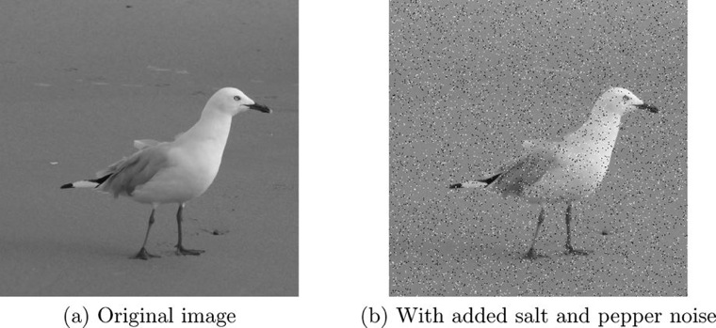
Salt & Pepper Noise
A.k.a. – impulse noise, shot noise, binary noise
Cause
sharp, sudden disturbances in the image signal
Appearance
Randomly scattered white or black (or both) pixels over the image

Slide 6
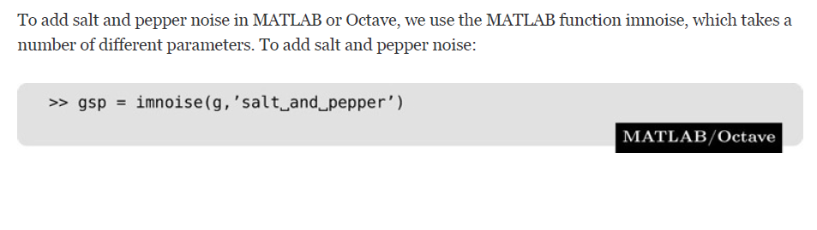
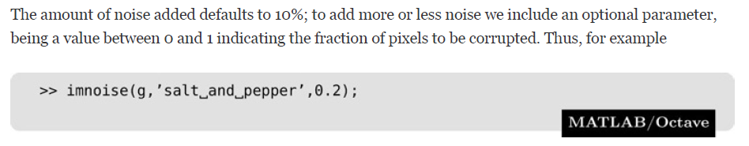
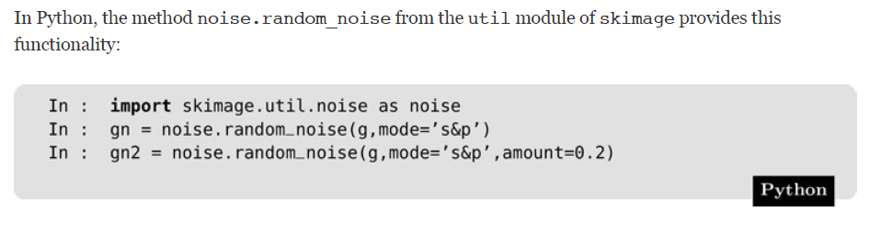
Salt & Pepper Noise

Slide 7
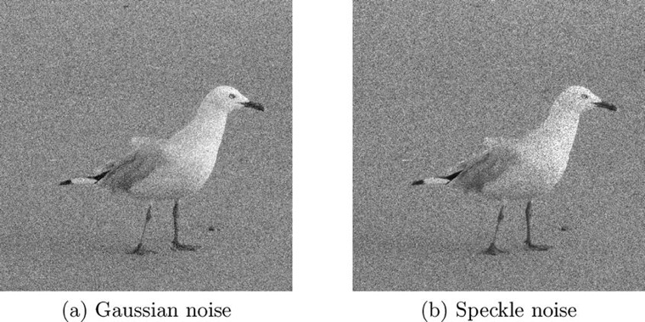
Gaussian Noise
Definition: idealized form of white noise that is normally distributed
Can be modeled by random values added to an image
Cause:
Random fluctuations in the signal
Example:
Television slightly mistuned to a particular channel

Slide 8
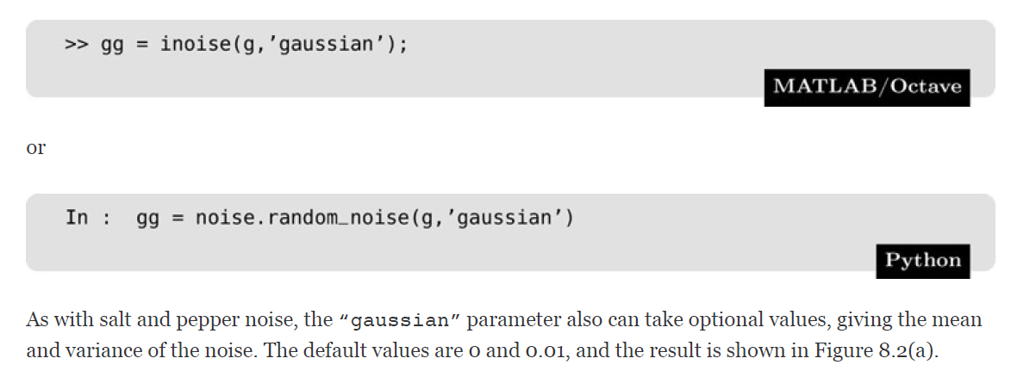
Gaussian Noise

Slide 9
Speckle Noise
A.k.a. – multiplicative noise
Can be modeled by random values multiplied by pixel values
Major problem in some radar applications

Slide 10
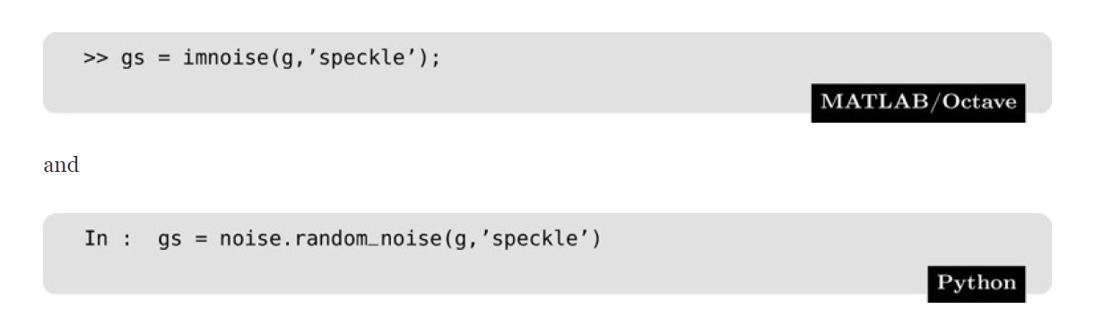
Speckle Noise

Slide 11
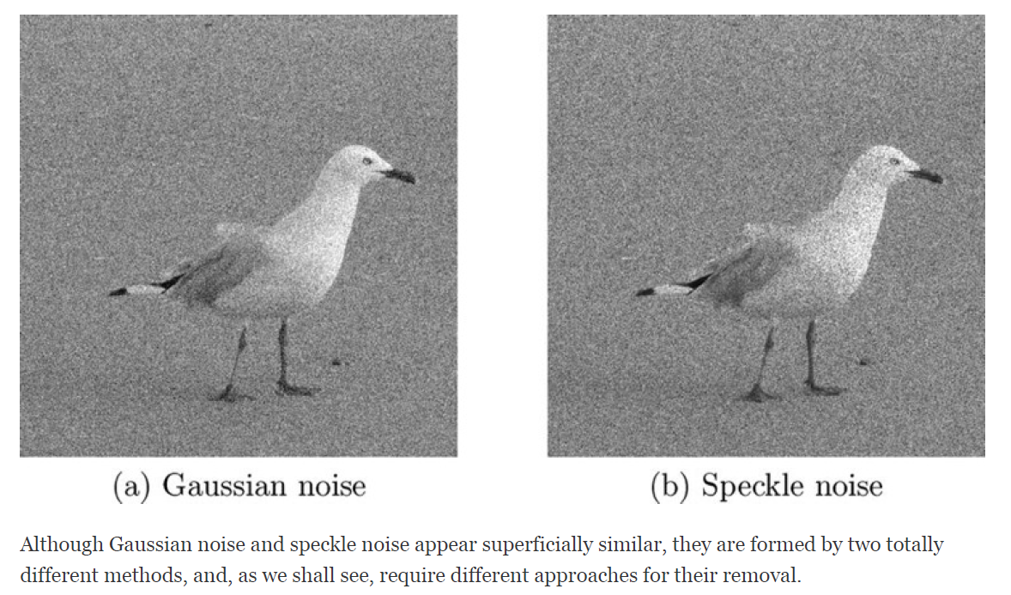
Gaussian vs. Speckle Noise

Slide 12
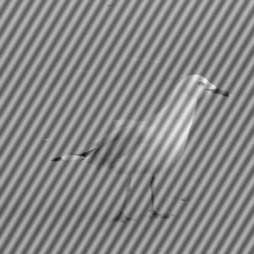
Periodic Noise
Occurs when an image is subject to a periodic disturbance
Effect of bars over the image
Figure 8.3: The gull image corrupted by periodic noise

Slide 13
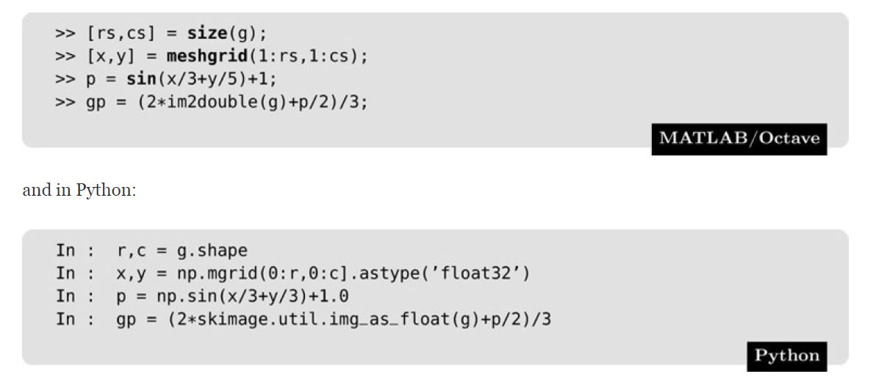
Periodic Noise
Neither function imnoise or random_noise has a periodic option, but it is quite easy to create such noise, by adding a periodic matrix (using a trigonometric function) to the image.

Slide 14
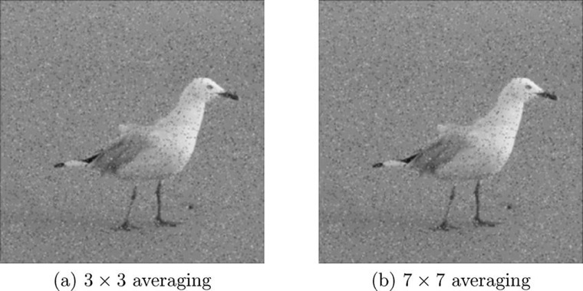
Cleaning Salt & Pepper Noise
Low Pass Filtering
Pixels corrupted by salt & pepper noise are high frequency components of an image, can expect a low pass filter should reduce them
Figure 8.4: Attempting to clean salt and pepper noise with average filtering

Slide 15
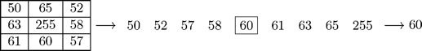
Cleaning Salt & Pepper Noise
Median filtering
Almost tailor made for removal of salt & pepper noise
example of a non-linear spatial filter
Using 3 x 3 mask, output value is median of values in the mask
Very large or very small values (noisy values) end up at the top or bottom of the sorted list
Replaces noisy value with one closer to its surroundings

Slide 16
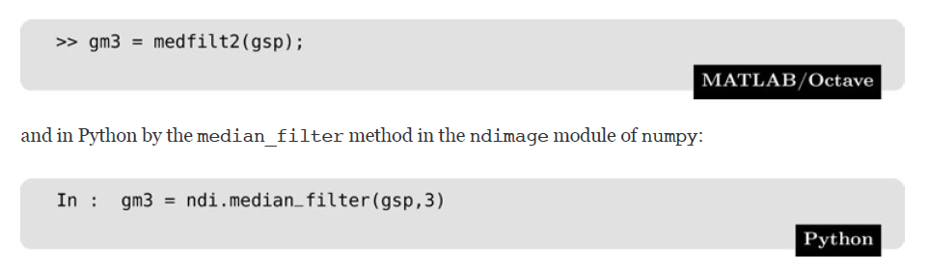
Cleaning Salt & Pepper Noise

Slide 17
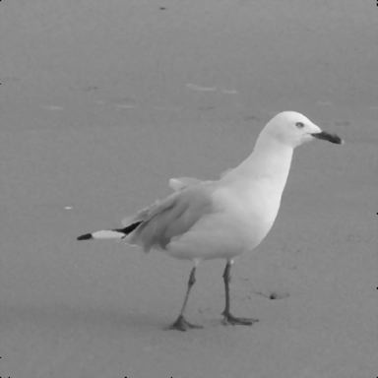
Cleaning Salt & Pepper Noise
Figure 8.5: Cleaning salt and pepper noise with a median filter

Slide 18

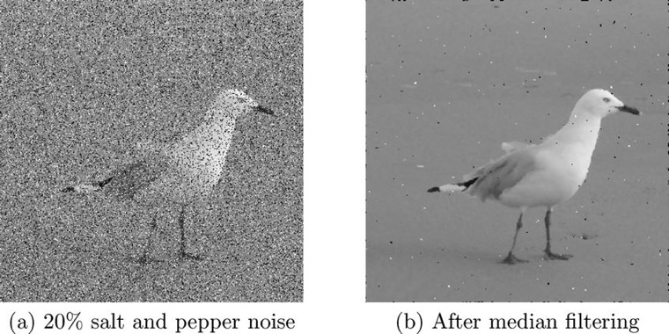
Cleaning Salt & Pepper Noise
MORE NOISE!!!!

Slide 19
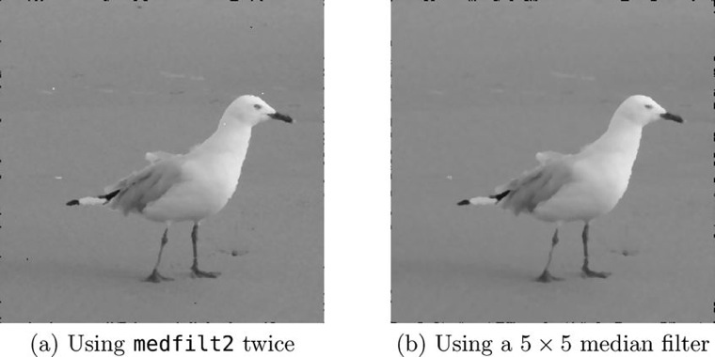
Cleaning Salt & Pepper Noise
Figure 8.7: Cleaning 20% salt and pepper noise with median filtering

Slide 20
Cleaning Salt & Pepper Noise
Rank-Order Filtering
N^{th} value of ordered list is chosen, for some predetermined value of n
When to use Rank-Order filtering instead of median filtering?
When using a median filter over non-rectangular masks

Slide 21
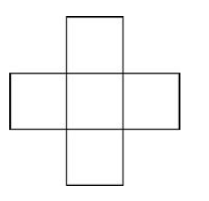
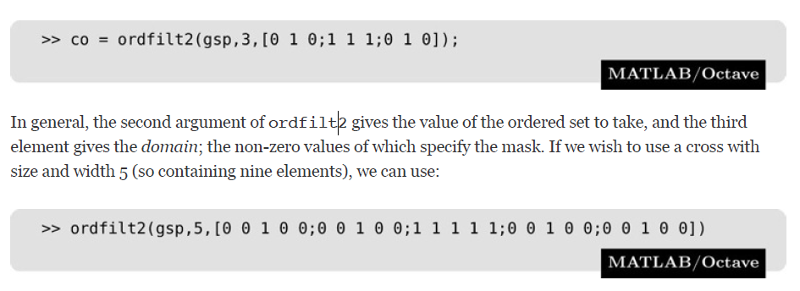
Cleaning Salt & Pepper Noise
Rank-Order Filtering

Slide 22
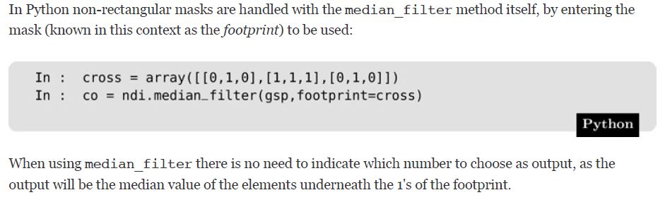
Cleaning Salt & Pepper Noise
Rank-Order Filtering

Slide 23
Cleaning Salt & Pepper Noise
Outlier Method
treat noisy pixels as outliers
Outliers are pixels whose gray values are significantly different from those of their neighbors
Approach:
Choose a threshold value D
For a given pixel, compare its value p with the mean m of the values of its eight neighbors
If |p – m| > D, then classify the pixel as noisy
If the pixel is noisy, replace its value with m
Choosing the right D value is essential!

Slide 24
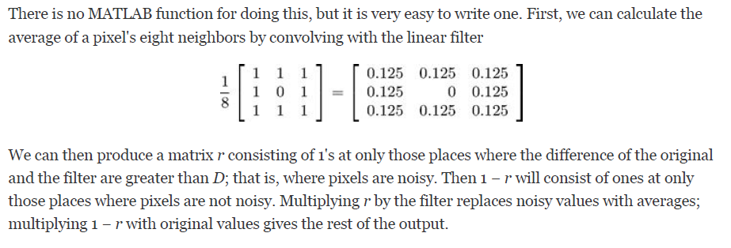
Cleaning Salt & Pepper Noise
Outlier Method

Slide 25
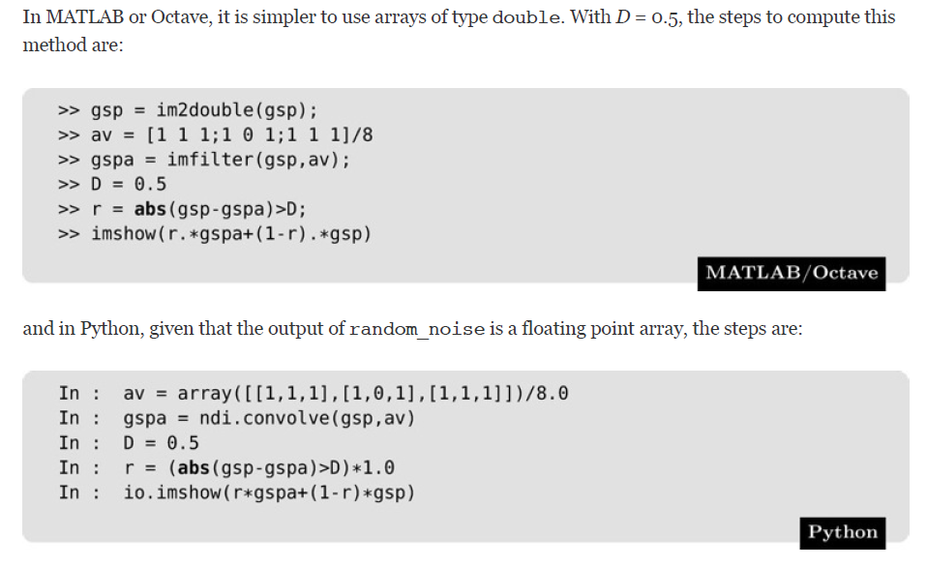
Cleaning Salt & Pepper Noise
Create a matrix of 1's over noisy pixels
If a pixel is noisy (r = 1), use the new pixel value (average of neighbors stored in gspa), but if it is not noisy (r = 0), use the original pixel value (stored in gsp)

Slide 26
Cleaning Gaussian Noise
Image Averaging
Sometimes we have different copies of an image corrupted with Gaussian noise
Example:
Satellite imaging
Satellite passes over the same spot many times, taking pictures, many different images of the same place
Microscopy
Many different images of the same object are taken
When these types of problems occur, its very easy to take the average of all the images

Slide 27
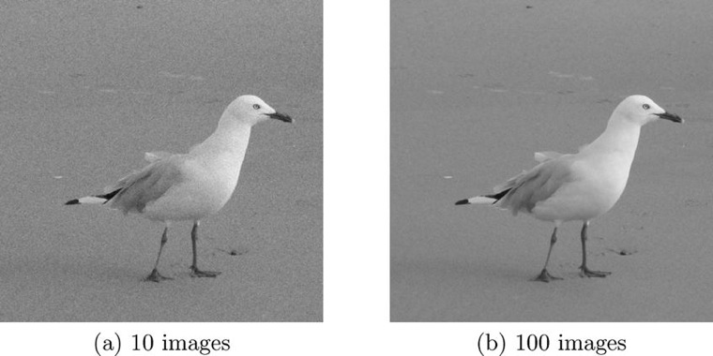
Cleaning Gaussian Noise
Figure 8.9: Image averaging to remove Gaussian noise

Slide 28
Cleaning Gaussian Noise
Average Filtering
If Gaussian noise has mean 0, expect average filter to average noise to 0
Larger the size of filter mask, the closer to 0
Unfortunately this tends to blur an image
Sometimes the tradeoff of blurring for noise reduction is worthwhile

Slide 29
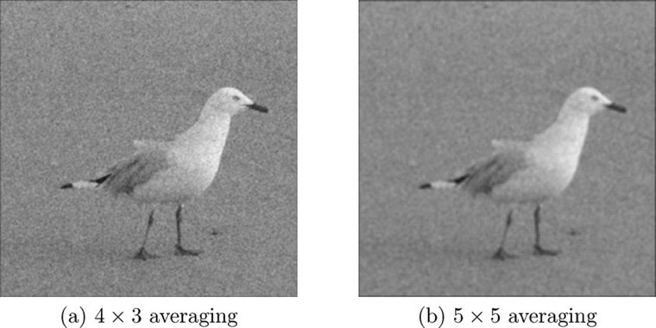
Cleaning Gaussian Noise
Figure 8.10: Using averaging filtering to remove Gaussian noise

Slide 30
Cleaning Gaussian Noise
Adaptive Filtering
Class of filters that change their characteristics according to the values of the grayscales under the mask
Cleans Guassian noise by using local statistical properties of the values under the mask
Minimum mean-square error filter
Non-linear spatial filter implemented by applying a function to the gray values under the mask
Name reflects that this filter attempts to minimize the square of the difference between the input and output images

Slide 31
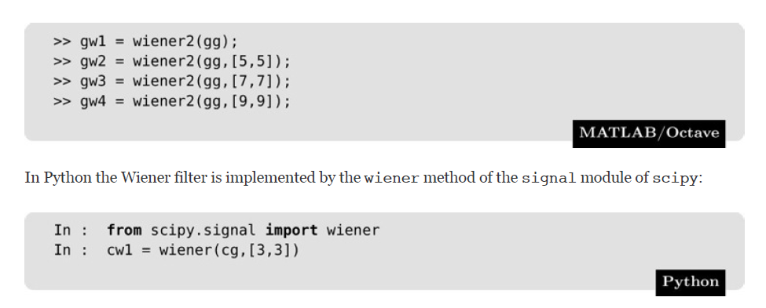
Cleaning Gaussian Noise
Adaptive Filtering
We will use the wiener filter (developed by Norbert Wiener in 1942), which can take an optional parameter indicating the size of the mask to be used. The default size is 3 × 3. We shall create four images:

Slide 32
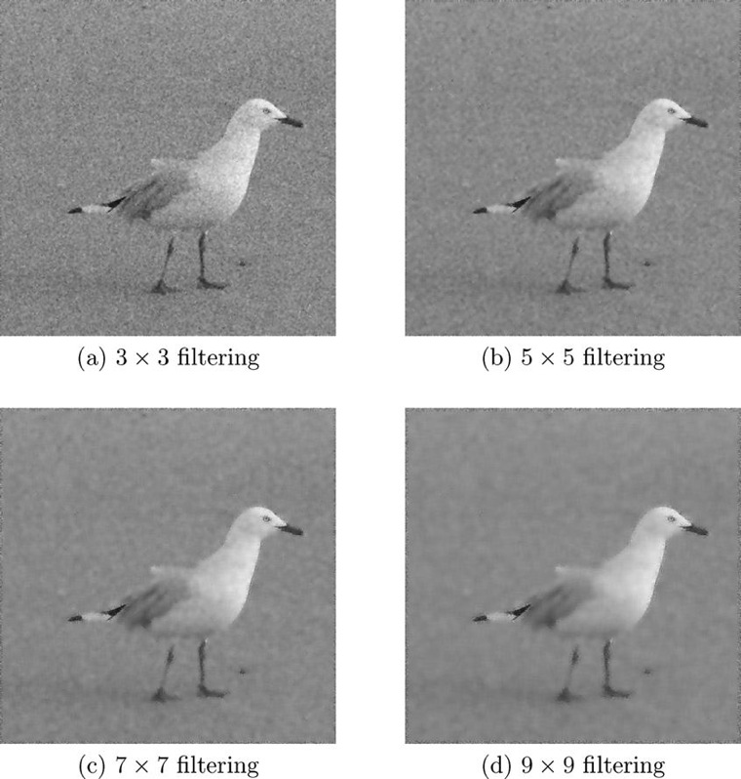
Cleaning Gaussian Noise
Figure 8.11: Examples of adaptive filtering to remove Gaussian noise

Slide 33
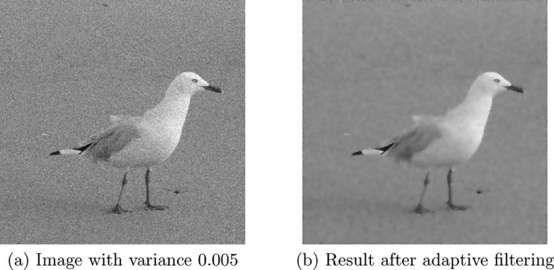
Cleaning Gaussian Noise
Figure 8.12: Using adaptive filtering to remove Gaussian noise with low variance

Slide 34
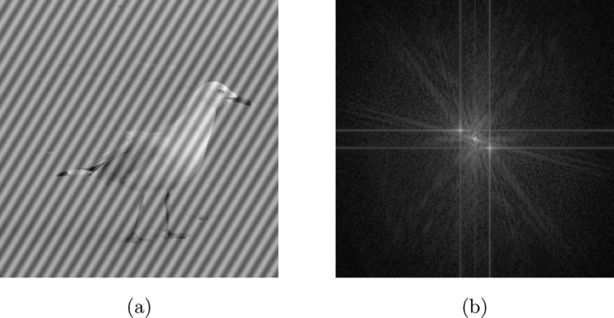
Removal of Periodic Noise
Periodic noise occurs when imaging equipment is subject to electronic disturbances of a repeating nature
Figure 8.13: The gull image (a) with periodic noise and (b) its transform

Slide 35
Removal of Periodic Noise
Figure 8.13: The gull image (b) its transform
Extra 2 spikes in 8.3(b) correspond to the added noise
In general, the tighter the period of the noise, the further from the center the spikes will be
Because small period corresponds to high frequency
Methods to remove spikes
Band reject filtering
Criss-cross filtering

Slide 36
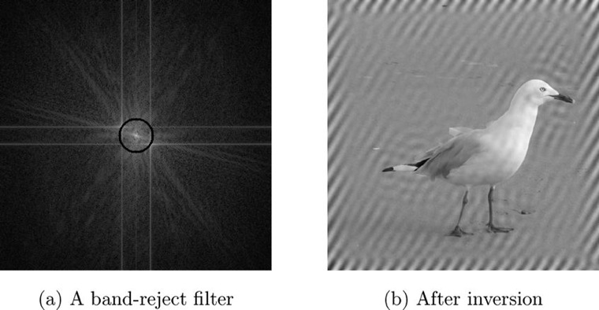
Band Reject Filtering
Figure 8.14: Removing periodic noise with a band-reject filter

Slide 37
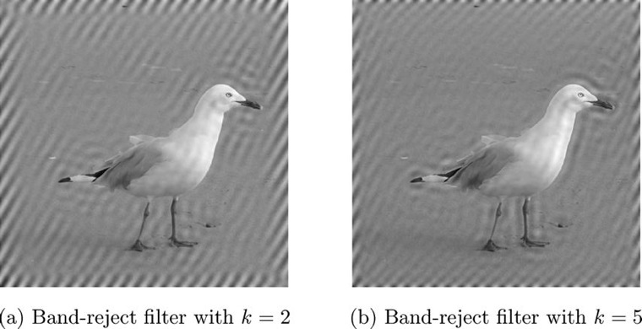
Band Reject Filtering
Figure 8.15: Removing periodic noise with wider band-reject filters

Slide 38
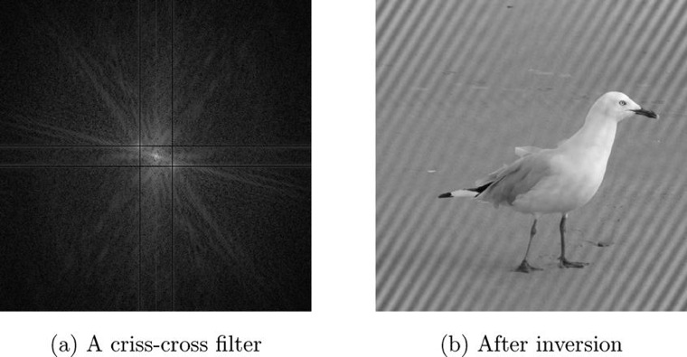
Criss-Cross Filtering
A criss-cross filter sets the rows and columns of the transform that contain the spikes to zero
The more rows and columns of the transform that are set to zero, the better the noise reduction
Figure 8.16: Removing periodic noise with a criss-cross filter

Slide 39
Inverse
We can perform filtering in the Fourier domain by multiplying the DFT of an image by the DFT of a filter
Direct use of convolution theorem
Thus
X is DFT of image
F is DFT of filter
Y is DFT of result
With this, if given Y and F, we should be able to retrieve X

Slide 40
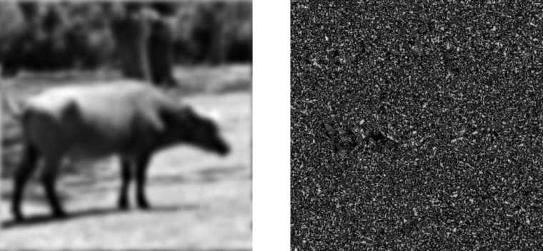
Inverse
1st attempt at inverse filtering
NO improvement! Now what?
Figure 8.17: An attempt at inverse filtering

Slide 41
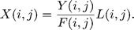
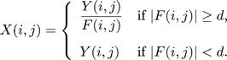
Inverse
Why no improvement?
Some elements of Butterworth matrix are very small
Dividing produces very large values that dominate output
Two steps for improved results
Apply a low pass filter L to the division:
Eliminates very low (zero) values
“Constrained division”: choose a threshold value d, and if |F(i, j)| < d, the original value is returned instead of a division. Thus:

Slide 42
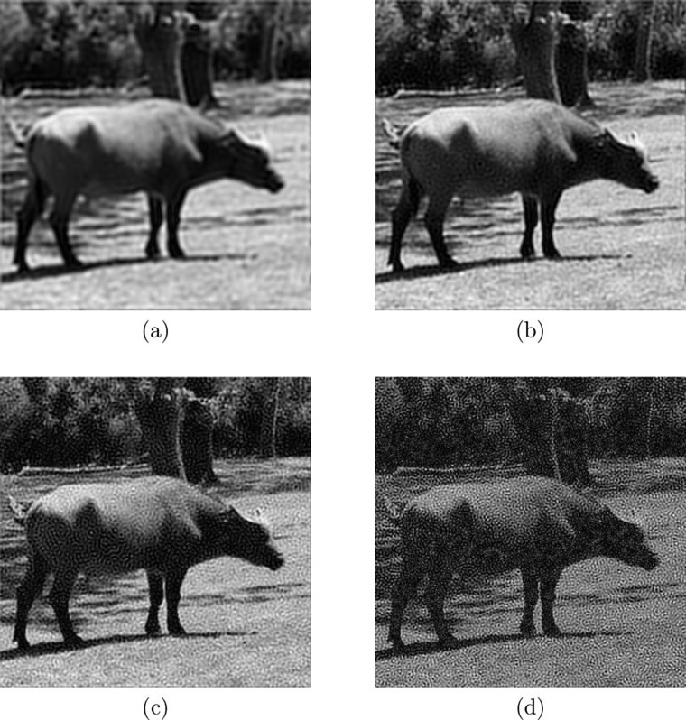
Method 1
Figure 8.18: Inverse filtering using low pass filtering to eliminate zeros
Implementation
Multiply a Butterworth low pass filter to the matrix
Butterworth cutoff radius
(a) 40
(b) 60
(c) 80
(d) 100
Low pass filter with cutoff about 60 yields best results

Slide 43
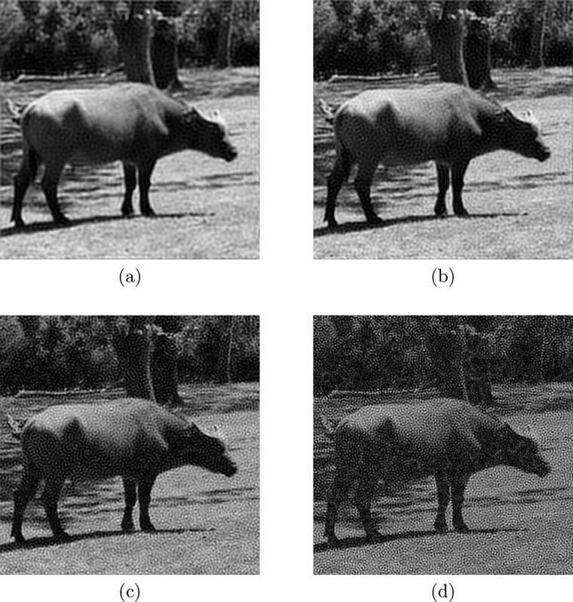
Method 2
Figure 8.19: Inverse filtering using constrained division
Implementation
Make all values of the filter that are too small equal to 1
Butterworth cutoff radius
(a) d = 0.01
(b) d = 0.005
(c) d = 0.002
(d) d = 0.001
Using a threshold d in the range 0.002 ≤ d ≤ 0.005 produce reasonable results

Slide 44
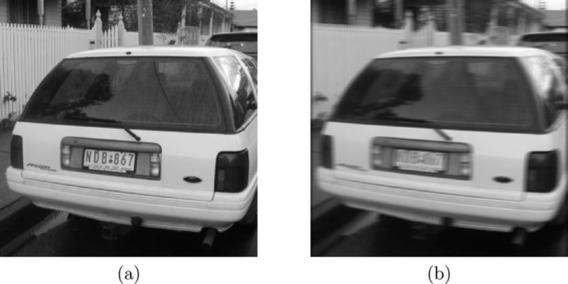
Motion Deblurring
Blurring caused by motion
Figure 8.20: The result of motion blur

Slide 45
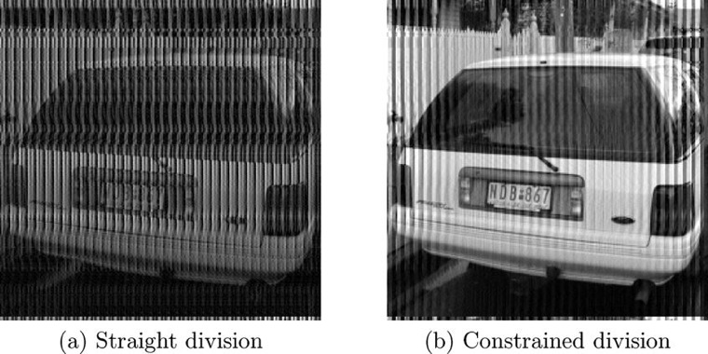
Motion Deblurring
Deblurring the image using DFTs
Divide image transform by the transform corresponding to the blur filter
How?
Create a matrix corresponding to the transform of the blur
Divide by this transform
We see poor results because values close to zero dominate the result (use constrained division to clean up the blur)

Slide 46
Weiner Filtering
Given a degraded image M’ of some original image M and a restored version R, what measure can we use to say whether our restoration has done a good job?
Want R to be as close as possible to correct image M
Measure closeness by adding the squares of all the differences
Goal: Minimize the closeness measure
Weiner filter: a filter that operates on the principle of least squares

Slide 47
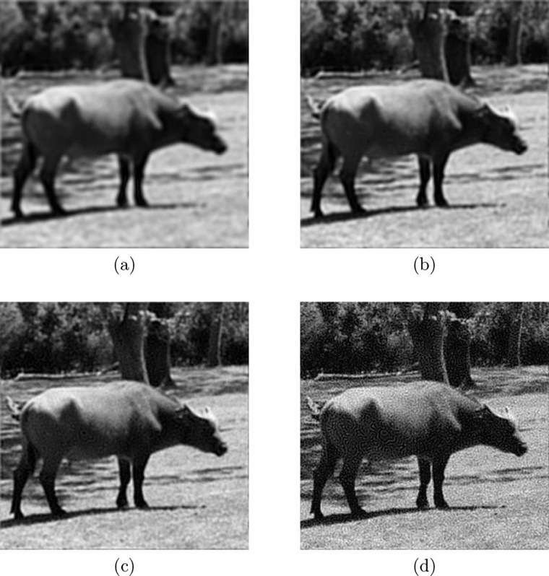
Weiner Filtering
Figure 8.22: Wiener filtering
K values
(a) K = 0.01
(b) K = 0.001
(c) K = 0.0001
(d) K = 0.00001
Note that as K becomes very small, noise starts to dominate the image

